Slide 1



Scheduling Algorithm Research:
Fleet maintenance optimisation
Data7902 Capstone Project
Presenter: David Long
Notes:
Today I will present the complete journey through both iterations of the scheduling algorithm research. The goal was to improve daily aircraft availability by changing maintenance timing while preserving the maintenance rules. Iteration 1 established the objective and made the search practical. Iteration 2 tested whether a more exploratory method could improve it, investigated starting schedules, and finished a wider hyperparameter study. I will focus on the measured findings and the final recommendation. The supporting diagrams and earlier plots are available after the references for questions.

Slide 2

The aircraft maintenance scheduling problem
Multiple aircraft go through routine checks concurrently
Concurrent maintenance creates dips in fleet availability. Staggered checks must preserve start windows and maintenance rules.
Finite resources such as dock space, mechanics, and components.
First: maximise worst-day availability.
Then: reduce standard deviation.
Notes:
The scheduling problem starts when several aircraft enter maintenance at similar times. Availability then falls even if the average across the year looks acceptable. The decision variable is the start of a check inside its legal start window. Checks must not overlap on one aircraft, and changing one check must preserve the sequence and the reset rules for later checks. The score ranks worst-day availability first, lower population standard deviation second, and mean availability last. A smoother schedule cannot compensate for a lower worst day. Random failures and resource shortages motivate the problem, but the reported experiments model scheduled maintenance. Source: CONTEXT.md and the completed technical report dated 12 October 2026.

Slide 3



Simple fleet proof of concept
10 aircraft, 80 checks. Keep the best feasible improvement at each iteration.
Notes:
The first proof of concept used ten aircraft with eight checks each. Each check lasted sixty days, and the model constrained maintenance intervals to the supplied window. The flowchart shows the basic search loop: calculate daily availability, score the schedule, generate neighbours by shifting one check, reject infeasible candidates, and keep the best improvement. Larger timing changes came before smaller changes. On the right, the resulting simple-fleet schedule retains at least eight available aircraft, which was the original target. This established the objective and feasibility checks before the heavy maintenance model made the neighbourhood much larger. Source: presentations/Iteration 1.pptx and Iteration 1 Milestones.pptx.

Slide 4


The heavy maintenance forecast
24 aircraft and 278 checks
A, B, C and D maintenance checks
Sequence: A B A C A B A D
12-year forecast
Notes:
The heavy forecast contains twenty-four aircraft and two hundred and seventy-eight supplied checks over roughly twelve years. It adds A, B, C, and D check types, with different durations and maintenance reset rules. The repeating sequence is shown on the slide. The availability plot makes the central difficulty visible: long checks can overlap and create a sustained dip. In this model, shifting one check can change the due clocks for later checks on the same aircraft. The optimiser therefore needs to rebuild the later schedule rather than treating every start as an independent variable. The displayed table and plot come from the original iteration presentation.

Slide 5

Scaling the search: Random Sampling method
The heavy fleet creates over 1,000 neighbours per iteration.
Full evaluation becomes too slow.
Sampling 200 neighbours reduces work.
Not deterministic, only reproducible with same seed
Random selection can miss a useful move.
Notes:
When the same neighbourhood search scaled to the heavy forecast, an iteration could produce over a thousand candidate schedules. Fully copying, checking, and scoring each one was expensive. Sampling two hundred neighbours reduced the work but introduced uncertainty, because the sample could omit a useful improving move. The next change used the structure of the problem: checks covering the worst availability days are the most relevant place to search first. Priority selection therefore concentrates the work deterministically, while widening the search when a worse priority group cannot improve. Source: Iteration 1 milestone slides 5 to 7.

Slide 6
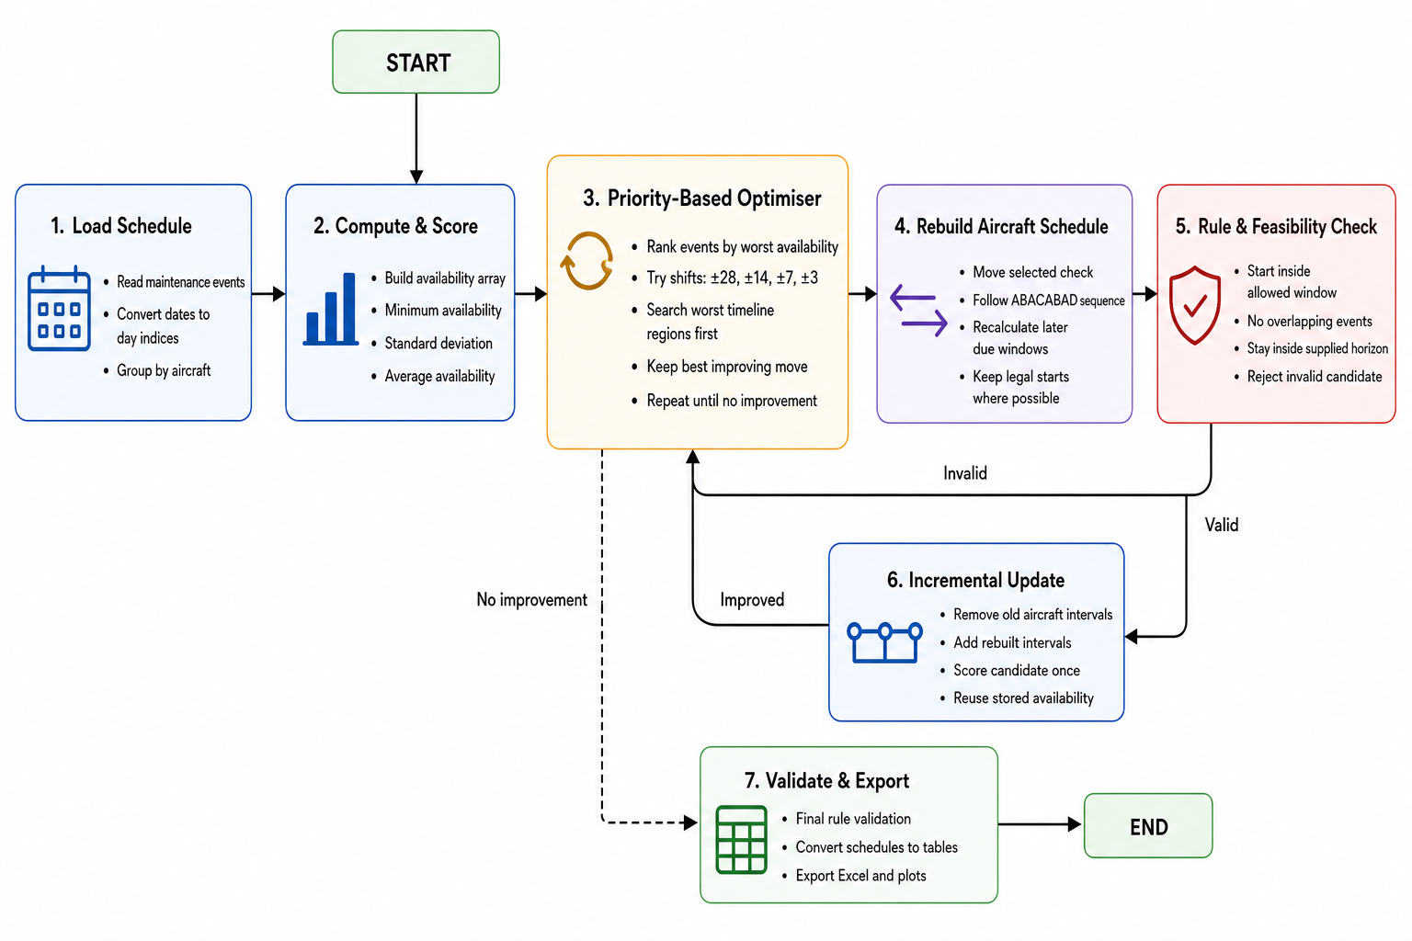
PRIORITY BASED SELECTION WITH VARIABLE NEIGHBOURHOOD SEARCH
Priority selection searches the worst availability regions first
Rank events by the worst availability during their interval.
Search the worst priority level first, expand only if needed.
Move one check, then rebuild later events using A/B/C/D rules.
Update incrementally and score once.
Deterministic, rule-compliant, and substantially faster.
Measured result: min 15→18, std 1.96→1.44.
Notes:
This is the method I want to spend the most time on, because it is the main technical result of iteration 1.
Priority-based selection changes the question we ask. Instead of asking “what happens if we try random moves to find the best one?”, we ask “which maintenance events are actually hurting and causing the minimum availability to be the lowest?”
How this algorithm works is for every event, it gets a priority score equal to the lowest fleet availability of the event for every day it is active. So if an event overlaps a day when only fifteen aircraft are available on that day, then the event priority score is fifteen. Then the events with the lowest priority score will be the ones to be shifted first.
Another thing I changed is that when we move one check, we do not leave the rest of that aircraft’s plan sitting in a potentially broken state. Before, when we move one maintenance check, only that selected event is shifted. Now when an event is shifted, the schedule is rebuilt, everything earlier on the same aircraft stays exactly as it was. Everything later is recalculated from the new shift date using the A/B/C/D rules, so the due dates will remain legal even after getting shifted.
I also changed how scoring works. The entire fleet is not deep copied for every trial. We rebuild one aircraft, then update availability incrementally. That aircraft’s old intervals are removed from the stored availability array, and the new rebuilt intervals are added, and scored once. That is much cheaper than recomputing availability from scratch for every neighbour.
---

Slide 7
Each event gets one priority: the worst day it covers
From the heavy starting schedule: global min availability = 15, 278 events, 24 aircraft
1. Score every event
2. Split into exclusive buckets
3. Search worst first
Look at fleet availability on every day that event is in the hangar.
Priority = the minimum of those days.
Example: event days with availability: [18, 18, 16, 15, etc.] → priority 15.
Level 15 → 20 events (touch a day-15 dip).
Level 16 → 10 events
Level 17 → 9 events
Level 21 → 68 events
Try only level-15 events × shifts (e.g. 20 × 2 = 40).
If any move improves the score, stop and pick the best.
Only then expand to 16, 17… if level 15 finds nothing.
Notes:
Now I want to walk through the mechanics of those priority levels.
The global minimum availability for the starting schedule is fifteen. First, we score every event. For each event we look at fleet availability on every day that the event is active, and the priority is the minimum of those days. For example, for an event, if the first day has an availability of 18, the second has 18, third has 16, and forth has 15 aircraft available, and so on, its priority is fifteen.
Second, we split the events into exclusive buckets by that priority. In our starting schedule we had twenty events at level fifteen, ten at sixteen, nine at seventeen, and larger groups at higher levels. So level 21 had the most events. An event sits in only one bucket: the bucket for its own worst day. So the twenty events at fifteen and the ten at sixteen are different events.
Third, we search the worst buckets first. For a shift set like plus and minus twenty-eight, level fifteen is about twenty events times two shifts, so around forty candidates. If any of those moves improve the score, we stop at that level for the iteration and take the best improving move. We only expand to level sixteen, then seventeen, and so on if the worse levels find nothing.
That is why the method is both targeted and fast. We are not randomly discarding most of the neighbourhood. We are concentrating effort on the events that touch the availability floor, and we only widen the search when we have to. And for higher levels like 21 where there are a lot of events, the algorithm converged at level 18 so the algorithm never needed to search that many neighbours.
---

Slide 8
Priority selection made the heavy search practical
WORST-DAY AVAILABILITY
SEARCH STRATEGY
VALIDITY
15 to 18
Worst days first
Rebuilt every time we find improvement
Historical runtime comparison from the Iteration 1 milestone
Full neighbourhood
920 s
200 random samples
451 s
Priority selection
15.4 s
Notes:
The historical milestone comparison reported about nine hundred and twenty seconds for full neighbourhood search, four hundred and fifty-one seconds for two hundred random samples, and fifteen point four seconds for priority selection. That is approximately sixty times faster than full search and thirty times faster than the sampled method in that benchmark. The primary result was an improvement from fifteen to eighteen available aircraft on the worst day. These are the historical Iteration 1 measurements. They are not directly comparable with the timings in the new hyperparameter study, which uses a matched scoring window and a verified study driver. Source: Iteration 1 Milestones.pptx slide 9.

Slide 9
SIMULATED ANNEALING
What simulated annealing is
1 · Search
2 · Accept
3 · Cool down
Same priority-based selection neighbour search algorithm
Better moves are always kept. Worse moves can still be kept early on, by chance.
Over time we accept fewer worse moves, so the search settles on a strong plan.
Why it helps
Think of the search like walking over hills. Today’s method only walks uphill. That is fast and safe, but you can get stuck on a steep part of the hill when a better peak is nearby.
Simulated annealing sometimes takes a downhill step early, so you can leave a trap and reach a better overall schedule. As the search “cools,” those downhill steps become rare, and we settle on the best plan we found.
Notes:
So what is simulated annealing.
Simulated annealing is a search method. The idea comes from metalworking: heating metal allows it to bend, then cool it slowly so it settles into a strong structure. In optimisation, “heat” means we are more willing to try unusual moves. “Cooling” means we become stricter over time.
There are three simple steps.
First, search. We propose a change to the maintenance schedule — for example, shift a check a few days earlier or later — then evaluate the new plan with the same availability score we already use: minimum availability first, then smoothness, then average. We are not inventing a new scoring system here.
Second, accept. If the new plan is better, we keep it. That part is familiar. The difference is early in the search we may also keep a slightly worse plan, by chance. That sounds odd, but it is deliberate. A temporary worse move can get us out of a local minima.
Third, cool down. As the search continues, we accept fewer and fewer worse moves. Near the end, we mostly behave like today’s method: keep improvements, reject clear steps backwards.
So if we were walking up a hill, sometimes we might need to take a step downhill just to find a better path rather than constantly going up a hill that might be steep. If we accept worse moves temporarily, we might find an easier path.
What annealing does need later is a fair acceptance rule for those temporary worse moves — because our score is a ranked tuple, not one number. That is an acceptance detail, not a new objective. Next I will show how this idea maps onto the optimiser we already built.

Slide 10
METHOD COMPARISON
Simulated Annealing did not meet the keep rule
Method | Worst day | Std deviation | Runtime
Tuned Priority Based Selection with VNS | 18 | 1.391860 | 115.6 s
Simulated Annealing median | 18 | 1.390417 | 306.3 s
Tightened acceptance median | 18 | 1.391860 | 63.5 s
Smoothness gain: 0.00144 against a 0.005 threshold. Median runtime exceeded 300 s.
Earlier decision benchmark. Simulated Annealing seeds 1–3. Two runs reached the time budget.
Notes:
On the original decision benchmark, all reported methods retained eighteen aircraft on the worst day. The tuned Priority Based Selection with VNS achieved standard deviation about one point three nine two in one hundred and fifteen point six seconds. Simulated Annealing improved the median standard deviation by only zero point zero zero one four four, below the required zero point zero zero five. Its median runtime was three hundred and six point three seconds, just over the five-minute limit. Two runs reached the time budget. Tightened acceptance matched the Priority Based Selection with VNS quality. The candidate therefore failed both the smoothness threshold and the runtime criterion. These values use the earlier decision-study horizon and must not be compared numerically with the later matched hyperparameter scores. Source: .scratch/iteration-2/study-results.json, decision section.

Slide 11
CONTROLLED START SCHEDULES
The as-loaded start finished smoothest
Start schedule | Initial worst day | Final worst day | Final std deviation
As-loaded | 15 | 18 | 1.414
Moderate | 15 | 19 | 0.944
Wide | 15 | 20 | 0.713
Instead of focusing on the algorithm which cannot be improved further because of constraints, I decided to focus on the initial stagger. In the normal heavy dataset, all the D checks happen at once. What if we move the D checks around? First, I did moderate spread of the D checks then widespread.
Notes:
This earlier experiment changes the opening start schedule for the same original checks and due dates. The three starts are as-loaded, bunched, and spread. All begin at a worst-day availability of fifteen and finish at eighteen with the tuned Priority Based Selection with VNS. The as-loaded start finishes smoothest. Simulated Annealing adds a small smoothness improvement on each start but takes longer. This supports retaining the as-loaded start for that original instance. It does not show that a more widely staggered fleet is always worse. The new moderate and wide datasets have different maintenance ages and check mixes, so their results answer a different question. Source: .scratch/iteration-2/study-results.json, stagger section.

Slide 12
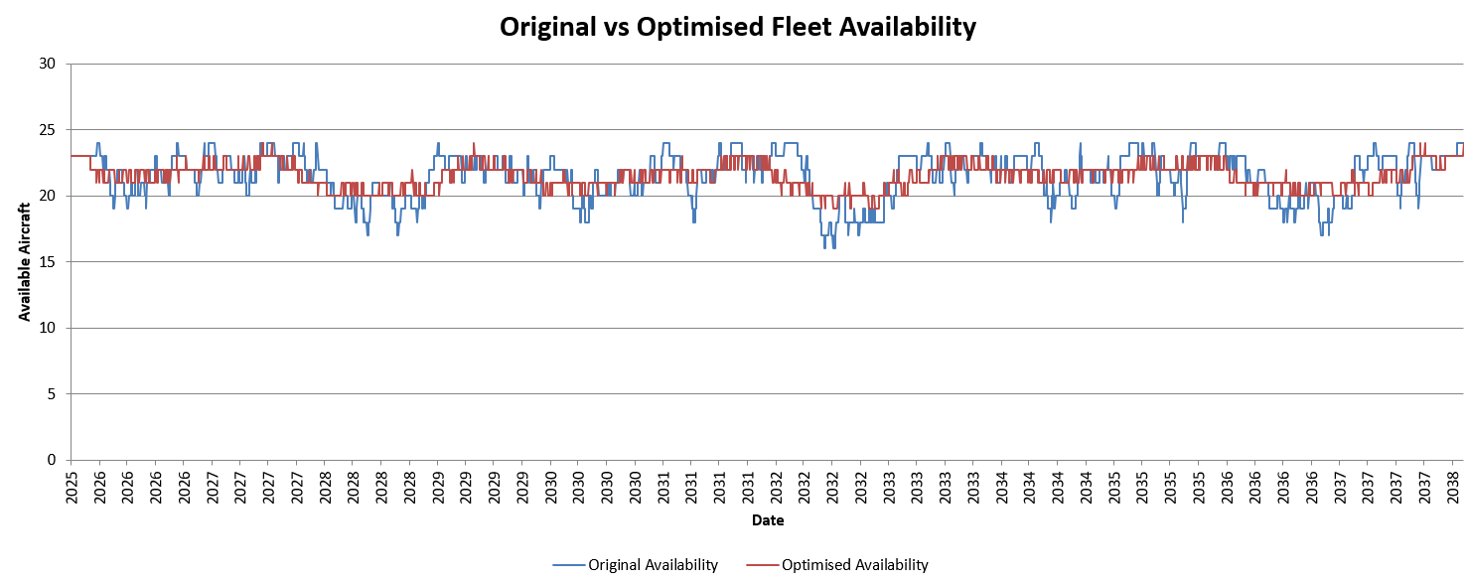
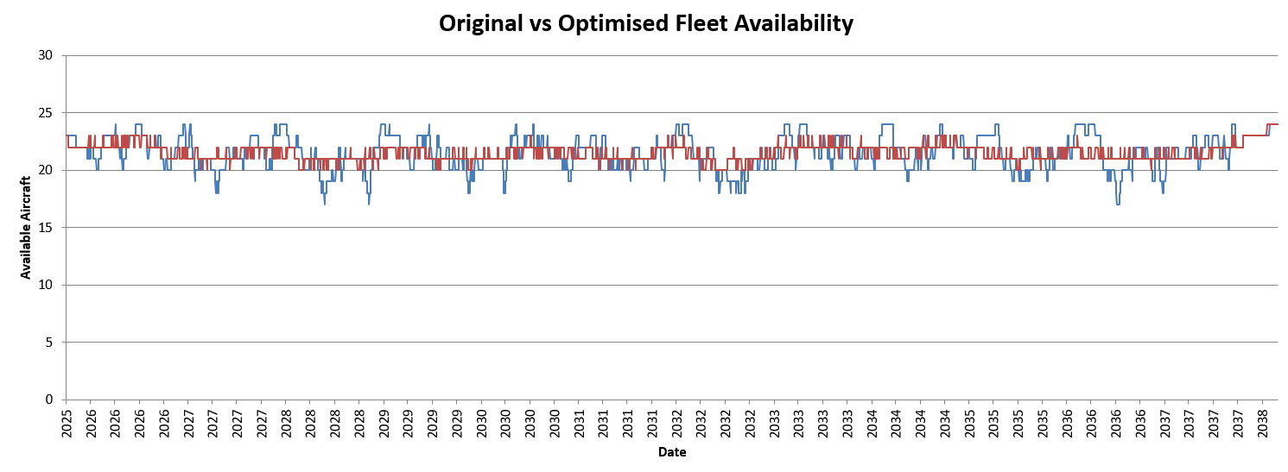
CONTROLLED START SCHEDULES
Moderate and Wide Staggers
Moderate initial stagger
Wide initial stagger
Notes:
This earlier experiment changes the opening start schedule for the same original checks and due dates. The three starts are as-loaded, bunched, and spread. All begin at a worst-day availability of fifteen and finish at eighteen with the tuned Priority Based Selection with VNS. The as-loaded start finishes smoothest. Simulated Annealing adds a small smoothness improvement on each start but takes longer. This supports retaining the as-loaded start for that original instance. It does not show that a more widely staggered fleet is always worse. The new moderate and wide datasets have different maintenance ages and check mixes, so their results answer a different question. Source: .scratch/iteration-2/study-results.json, stagger section.

Slide 13
HYPERPARAMETER RESULTS
Tuning improved smoothness on every forecast
Dataset | Initial worst day | Tuned worst day | Default std | Tuned std | Results
Original | 15 | 18 | 1.4221 | 1.4019 | 1.42%
Moderate | 16 | 19 | 0.9117 | 0.8834 | 3.1%
Wide | 17 | 20 | 0.6167 | 0.5868 | 4.85%
Smoothness improvement at the same worst day: 1.42%, 3.10% and 4.85%
Notes:
The study compared fifty-eight step-size and selection combinations on each of three matched forecasts, giving one hundred and seventy-four sweep cases. The default used separate shifts of minus and plus twenty-eight, fourteen, seven, and three days. For the original forecast, adding a forty-two-day level and pairing large and small shifts produced the best measured smoothness: 1.401929, with eighteen aircraft on the worst day. For moderate and wide stagger, the separate wide steps gave smoothness of 0.883419 and 0.586797, retaining nineteen and twenty aircraft respectively. The exact step sets appear on the next slide. Improvements against the default on the same input are 1.42, 3.10, and 4.85 percent. All runs preserve maintenance legality and opening due clocks on the matched dates from 21 January 2026 to 18 January 2038. Timings are medians of three serial repeats on this machine. Source: the completed hyperparameter report dated 14 October 2026 and saved three-dataset study records.

Slide 14
HOW STEP SIZES WORK
A step size is a trial change to a check start date
Example: try a 14-day move
How the search repeats
Current start: Day 100
14 days earlier: Day 86
14 days later: Day 114
These are two alternative schedules.
Keep the better legal improvement.
Try the largest step size first.
Keep one best improving move.
Restart from the largest step size.
If no move improves the schedule,
try the next, smaller step size.
Which checks get tested first?
For each step size, test checks covering the worst availability days first.
Only search the other priority groups if the earlier groups find no improvement.
Notes:
A step size means the number of days added to or subtracted from one check start. It does not change the duration of that check. For a check currently starting on day 100, a minus-14 trial starts on day 86 and a plus-14 trial starts on day 114. These are different candidate schedules, not two changes applied together. A trial is usable only if it remains in the legal start window and rebuilding the aircraft later checks keeps the full schedule legal. The score first protects worst-day availability, then improves smoothness, and finally considers mean availability. Each search iteration starts from the largest neighbourhood. Within that neighbourhood, checks are grouped by the worst availability day they cover, and the worst group is searched first. The method examines all improving candidates within that group and chooses the best, rather than taking the first candidate encountered. If that group has no improvement, it tries the next priority group. If all groups fail for that step-size neighbourhood, it tries the next, smaller neighbourhood. After one improvement is accepted, it starts a new iteration, recomputes the priorities, and returns to the largest neighbourhood. Source: .scratch/priority-hyperparameter-analysis/run_three_datasets.py, neighbours and solve functions.

Slide 15
HYPERPARAMETER SETTINGS
Which trial moves worked best?
Original forecast
Moderate and wide forecasts
First try 42 days earlier or later.
If no move helps, try 28 or 14 days.
Next try 14 or 7, then 7 or 3,
then 3 or 1 day.
Each pair gives four trial moves.
First try 56 days earlier or later.
If no move helps, try 42 days,
then 28, 14, 7, 3 and 1 day.
Try one size at a time.
This is the shared recommendation.
When does the search stop?
Stop when none of the listed moves improves the schedule, or after 400 search iterations.
Each iteration accepts at most one move. The search can stop before reaching 400.
Notes:
These settings tune Priority Based Selection with Variable Neighbourhood Search. On the original forecast, the tested winning order was: first only minus and plus 42 days. If no improving legal candidate exists in any priority group at that neighbourhood, try four alternatives: minus 28, minus 14, plus 14, and plus 28 days. If that neighbourhood also fails, try minus 14, minus 7, plus 7, and plus 14. The next neighbourhood uses minus 7, minus 3, plus 3, and plus 7. The last uses minus 3, minus 1, plus 1, and plus 3. A pair means two alternative magnitudes in the same candidate batch. It does not mean add the sizes or move a check twice. For a check currently on day 100, the 28-and-14 batch proposes starts on days 72, 86, 114, and 128, assuming those dates and the rebuilt schedule are legal. The method then chooses one best improving schedule within the first priority group that can improve. On the moderate and wide forecasts, the winning order uses one magnitude per neighbourhood: 56, 42, 28, 14, 7, 3, and 1 day in either direction. Larger trial changes can produce different search paths, while the small steps allow finer adjustments. The winning settings were established by comparing the measured endpoints, not by assuming larger shifts must be better. After accepting a move, both strategies restart at their largest neighbourhood. Stop when every neighbourhood and priority group finds no improvement, or when the iteration cap is reached. The recommended cap is 400 iterations. The recorded winners needed 302, 367, and 291 accepted moves on original, moderate, and wide respectively, so 400 leaves room to confirm the final no-improvement pass. The parameter sweep used an 800-move cap and finalist extensions where needed. Source: three-dataset-results.json and run_three_datasets.py in .scratch/priority-hyperparameter-analysis, and the completed three-forecast report dated 14 October 2026.

Slide 16
LIMITS AND NEXT STEPS
Availability limits and remaining work
Original forecast
Moderate and wide stagger
18 aircraft
Best possible worst-day availability
Six D checks must overlap.
24 aircraft − 6 in maintenance = 18
19 and 20 aircraft
Best worst-day availability found so far
Upper limit: 21 on each dataset
Whether we can reach 21 is still open.
What remains open
Search for smoother original schedules and higher worst-day availability on the stagger datasets.
These findings apply to the tested dummy maintenance forecasts.
Notes:
Worst-day availability means the lowest number of aircraft available on any day of the forecast. In the original fleet, a D check lasts one hundred and twenty-six days and can start up to seventy days early. Every legal placement therefore covers a fixed fifty-six-day interval beginning at its due date. Six of those compulsory intervals overlap on the original forecast. That forces at least six aircraft into maintenance together, so the twenty-four-aircraft fleet can have no more than eighteen available on its worst day. Our result reaches eighteen, proving the primary objective optimal under these maintenance assumptions. This does not prove that the schedule has globally optimal smoothness. On the moderate and wide stagger inputs, the equivalent overlap gives an upper limit of twenty-one, but the best measured results reach nineteen and twenty. The bound does not prove twenty-one is reachable. The remaining work is to test whether those gaps can be reduced and whether smoother schedules exist. Source: 14 October 2026 three-forecast report, limits of the evidence section.

Slide 17
FINAL RECOMMENDATION
Final method: Priority Based Selection with VNS
METHOD
SHARED STEP SIZES
Priority Based Selection
with VNS
±56, ±42, ±28, ±14,
±7, ±3, ±1 days
Project outcome
Iteration 1 raised original worst-day availability from 15 to 18.
Simulated Annealing offered too little smoothness gain for its runtime.
Use the separate wide steps with a 400-iteration limit across these forecasts.
For the original forecast, paired shifts plus 42 days give the best measured smoothness.
Notes:
The final method remains Priority Based Selection with Variable Neighbourhood Search. For a shared setting on these three forecasts, use seven separate neighbourhood levels of minus and plus fifty-six, forty-two, twenty-eight, fourteen, seven, three, and one day, first-level priority selection, and a four-hundred-iteration limit. On the original forecast, the best measured smoothness instead uses a forty-two-day level followed by paired twenty-eight and fourteen, fourteen and seven, seven and three, and three and one-day shifts. Simulated Annealing did not meet the decision-study smoothness and runtime thresholds. These are explicit settings recommendations for the tested forecasts, rather than unexplained configuration codes.

